Slide 1



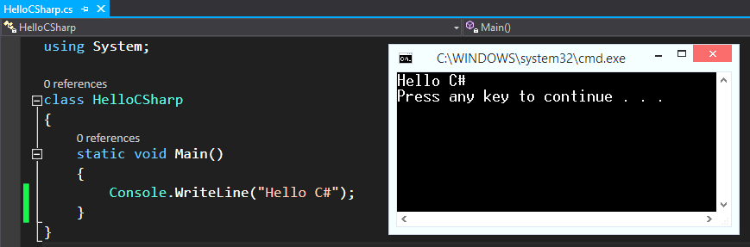
Introduction to Programming
Creating and Running Your First C# Program
Programming
Basics
SoftUni Team
Technical Trainers
Software University
http://softuni.bg

Slide 2

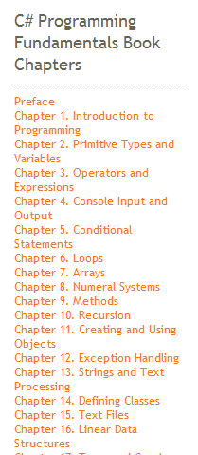
Table of Contents
What is Computer Programming?
Your First C# Program
What is C#?
What is .NET Framework?
What is Visual Studio?
Compiling, Running and Debugging C# Programs
What is MSDN Library?

Slide 3


What is Computer Programming?

Slide 4

Define: Computer Programming
Computer programming: creating a sequence of instructions to enable the computer to do something
Definition by Google

Slide 5
Software Development Phases
= Specification
= Architecture / Design
= Implementation
= Testing & Debugging
= Deployment
= Maintenance
Define a task / problem
Plan your solution
Find suitable algorithm / data structures to use
Find suitable libraries / platforms / frameworks
Write source code (step by step)
Fix program errors (bugs)
Install, configure and run the software
Fix / improve the software over time

Slide 6
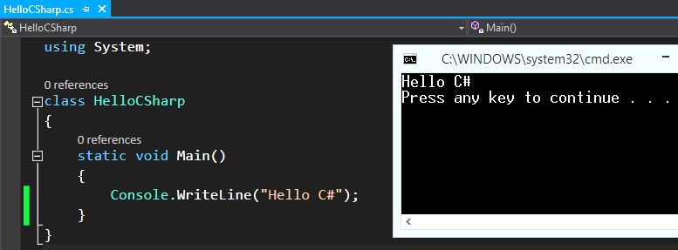

Your First C# Program

Slide 7
First Look at C#
Sample C# program: https://dotnetfiddle.net/
using System;
class HelloCSharp
{
static void Main()
{
Console.WriteLine("Hello, C#");
}
}

Slide 8
C# Code – How It Works?
Include the standard .NET namespace "System"
Define a class called "HelloCSharp"
using System;
class HelloCSharp
{
static void Main()
{
Console.WriteLine("Hello, C#");
}
}
Define the Main() method – the program entry point
Print a text on the console by calling the method "WriteLine" of the class "Console"

Slide 9
The C# Code Should Be Well Formatted
Class names should use PascalCase and start with a CAPITAL letter.
using System;
class HelloCSharp
{
static void Main()
{
Console.WriteLine("Hello, C#");
}
}
The { symbol should be alone on a new line.
The } symbol should be under the corresponding {.
The block after the { symbol should be indented by a TAB.

Slide 10
Example of Bad Code Formatting
Such formatting makes the source code unreadable
using
System
;
class HelloCSharp {
static
void Main( ) { Console . WriteLine ("Hello, C#" ) ;Console.
WriteLine ( "Hello again"
) ;}}

Slide 11

What is "C#"?
C# is a modern programming language
A syntax that allows to give instructions to the computer
C# features:
Extremely powerful
Easy to learn
Easy to read and understand
Object-oriented
Functional programming features

Slide 12
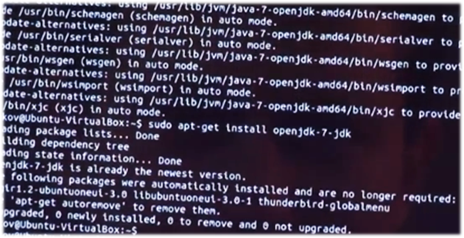

What You Need to Program?
A programming language
C#
Problem to solve
IDE, compilers, SDK
Visual Studio, .NET Framework SDK
Set of useful standard classes
Microsoft .NET Framework FCL
Help documentation
MSDN Library

Slide 13


Your First C# Program
Live Demo

Slide 14

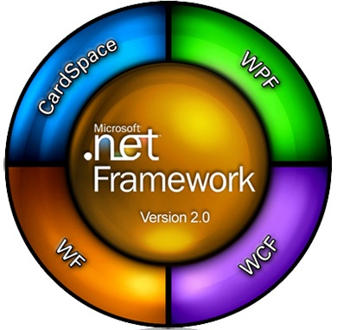

What is .NET Framework?
Download .NET Framework 4.6

Slide 15

What is .NET Framework?
Environment for execution of .NET programs (CLR)
Powerful library of classes (FCL)
Programming model
Common execution engine for many programming languages
C#
Visual Basic .NET
Managed C++
... and many others

Slide 16
Inside .NET Framework
The building blocks of .NET Framework
Languages
C#
VB.NET
Managed C++
F#
Python
Delphi
…
ASP.NET
MVC, Web Forms, Web API, SignalR
WPF & XAML
Windows Store Apps
Windows Forms
Silverlight,
WP7 / WP8
FCL
WCF, WWF (Communication / Workflow Tier)
ADO.NET, Entity Framework, LINQ, XML (Data Tier)
Base Class Library (BCL) – I/O, Threading, Collections, Strings, …
CLR
Common Language Runtime (CLR) + DLR (for Dynamic Languages)
OS
Operating System (Windows / Linux)

Slide 17
CLR – The Heart of .NET Framework
Common Language Runtime (CLR)
Managed execution environment (virtual machine)
Executes .NET applications
Controls the execution process
Automatic memory management (garbage collection)
Programming languages integration
Multiple versions support for assemblies
Integrated type safety and security
CLR

Slide 18
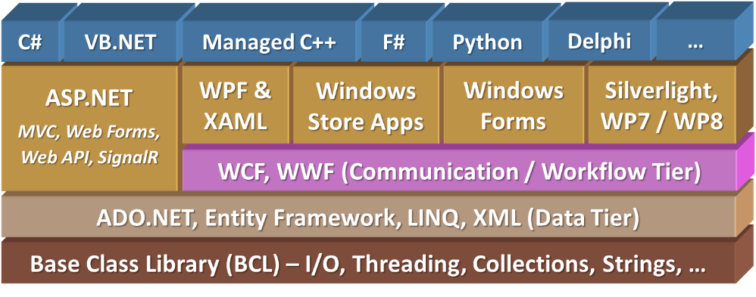

Framework Class Library
Framework Class Library (FCL)
Provides basic classes for developers:
Console applications
Web applications and web services
XAML, WPF, Silverlight rich-media applications
Windows Forms and WPF GUI applications
Windows Store applications
Database applications
Applications for mobile devices

Slide 19

What is Visual Studio?
Download Visual Studio Community 2015

Slide 20
Visual Studio
Visual Studio – Integrated Development Environment (IDE)
Development tool that helps us to:
Write code
Design user interface
Compile code
Execute / test / debug applications
Browse the help
Manage project's files

Slide 21

Benefits of Visual Studio
Single tool for:
Writing code in many languages (C#, VB.NET, Python, …)
Using different technologies (Web Forms, MVC, WPF, EF, WCF, …)
For different platforms (Win8, Silverlight, Windows Phone, …)
Full integration of most development activities (coding, compiling, testing, debugging, deployment, version control, ...)
Very easy to use!

Slide 22
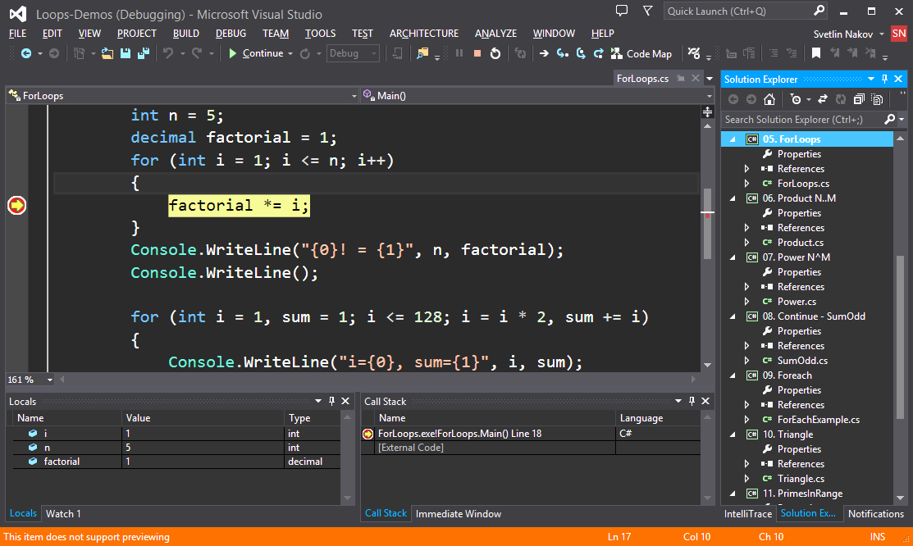
Visual Studio – Example

Slide 23
Visual Studio
Compiling, Running and Debugging C# Programs

Slide 24
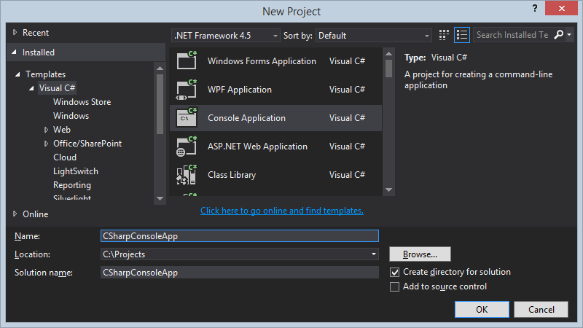
Creating New Console Application
File → New → Project ...
Choose Visual C# → Console Application
Choose project directory and name

Slide 25
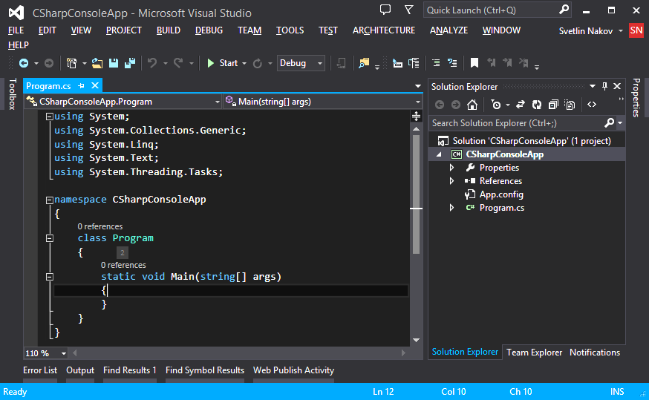
Creating New Console Application (2)
Visual Studio creates some source code for you
Most imports are not required
Namespace not required
Class name should be changed
File name should be changed

Slide 26
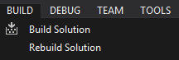
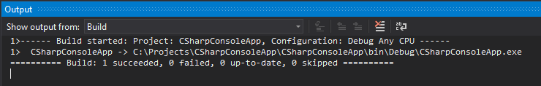
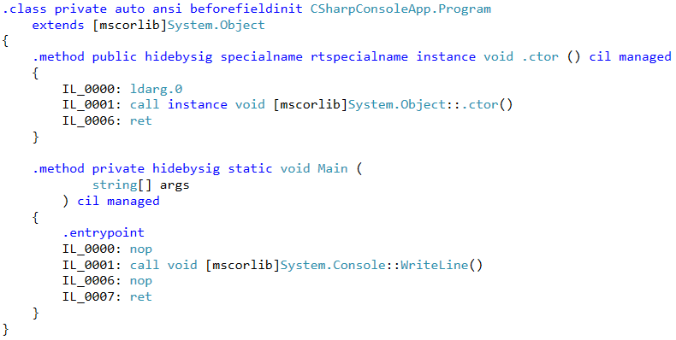
Compiling the Source Code
The process of compiling includes:
Syntactic checks
Type safety checks
Translation of the source code to lower level language (MSIL)
Creating executable files (assemblies)
You can start compilation by
Using Build->Build Solution/Project
Pressing [F6] or [Shift+Ctrl+B]

Slide 27


Running Programs
The process of running application includes:
Compiling (if project not compiled)
Starting the application
You can run application by:
Using Debug->Start menu
By pressing [F5] or [Ctrl+F5]
* NOTE: Not all types of projects can be started!

Slide 28



Debugging The Code
The process of debugging application includes:
Spotting an error
Finding the lines of code that cause the error
Fixing the error in the code
Testing to check if the error is gone and no new errors are introduced
Iterative and continuous process
Debuggers help a lot

Slide 29
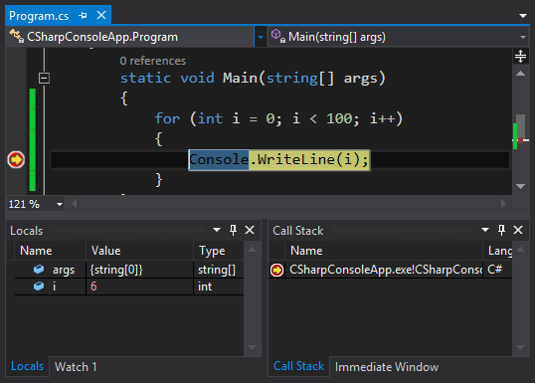
Debugging in Visual Studio
Visual Studio has a built-in debugger
It provides:
Breakpoints
Ability to trace the code execution
Ability to inspect variables at runtime

Slide 30

Visual Studio
Compiling, Running and Debugging C# Programs – Live Demo

Slide 31
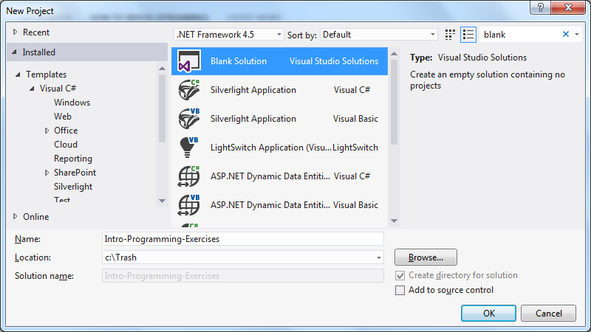

Visual Studio Blank Solution
Creating a Solution without any Projects

Slide 32
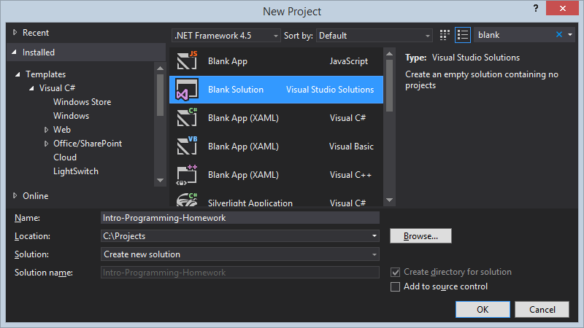
What Is a Blank Solution?
A Visual Studio blank solution
Solution with no projects in it
Projects to be added later
Why we need a blank solution in Visual Studio?
First create a blank solution for your homework
Then create a project for each assignment from the homework

Slide 33
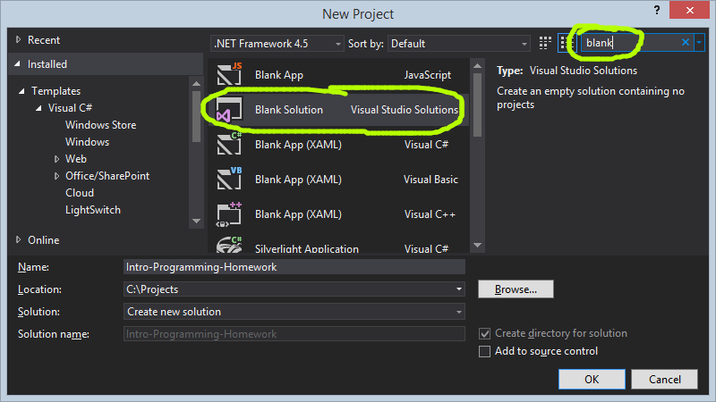
Creating a Blank Solution in Visual Studio

Slide 34

Visual Studio Blank Solution
Live Demo

Slide 35


Creating Projects
Exercise

Slide 36



What is MSDN Library?

Slide 37
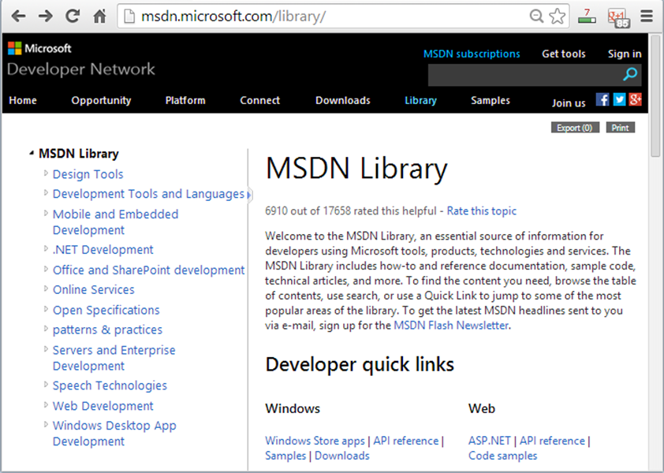
What is MSDN Library?
Complete documentation of all classes and their functionality
With descriptions of all methods, properties, events, etc.
With code examples
For all Microsoft technologies
Related articles
Library of samples
MSDN Library is available at msdn.microsoft.com/library

Slide 38

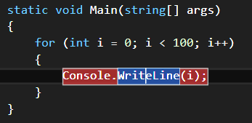
How to Use MSDN Library?
Search in Google for certain class / method / property
E.g.
Or
Or
Use Visual Studio's built-in help system
Press [F1] in Visual Studio in the code
Browse http://msdn.microsoft.com
Press [F1] to view the documentation

Slide 39
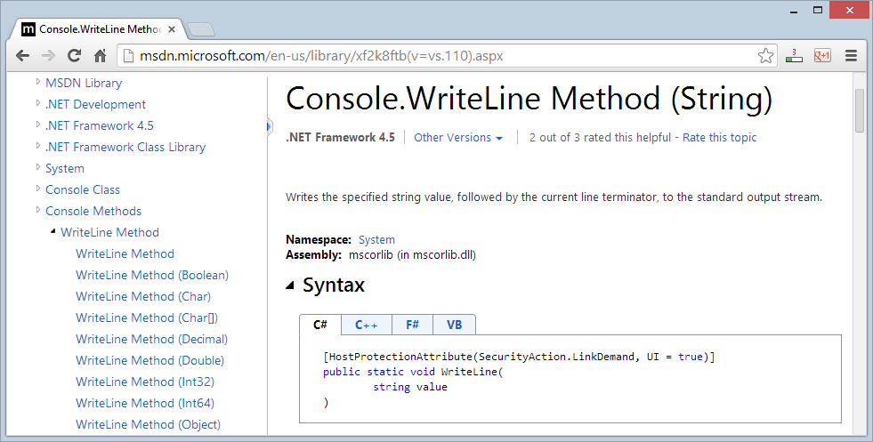
MSDN Library
Browsing the Documentation – Live Demo

Slide 40

Summary
Programming: creating a sequence of instructions (source code)
C#: modern programming language, easy to learn
C# programs: class + main method + code in it
.NET Framework – a modern platform for software development by Microsoft
Visual Studio – powerful IDE for .NET developers: write / compile / execute / debug code
MSDN Library – the C# and .NET documentation

Slide 41








Introduction to Programming
https://softuni.bg/courses/programming-basics/

Slide 42
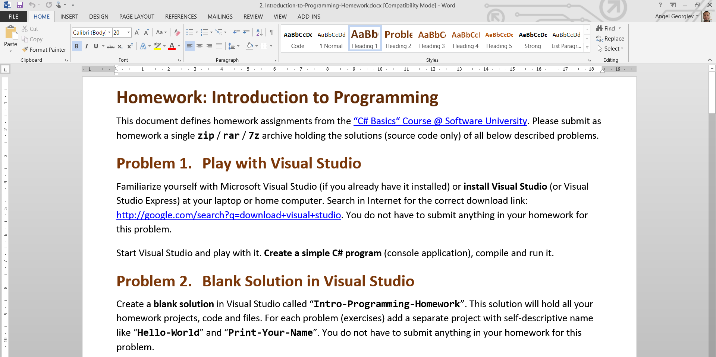
Homework Review
Live Demo

Slide 43
License
This course (slides, examples, demos, videos, homework, etc.) is licensed under the "Creative Commons Attribution-NonCommercial-ShareAlike 4.0 International" license
Attribution: this work may contain portions from
"Fundamentals of Computer Programming with C#" book by Svetlin Nakov & Co. under CC-BY-SA license
"C# Part I" course by Telerik Academy under CC-BY-NC-SA license

Slide 44






Free Trainings @ Software University
Software University Foundation – softuni.org
Software University – High-Quality Education, Profession and Job for Software Developers
softuni.bg
Software University @ Facebook
facebook.com/SoftwareUniversity
Software University @ YouTube
youtube.com/SoftwareUniversity
Software University Forums – forum.softuni.bg

